Slide 1
Modeling Rational Agents

Slide 2


Slide 3
Modeling Human Behavior
What is (mathematical) modeling?
A description of a system using mathematical concepts and language
May help to
explain a system
study the effects of different components
make predictions about behavior

Slide 4
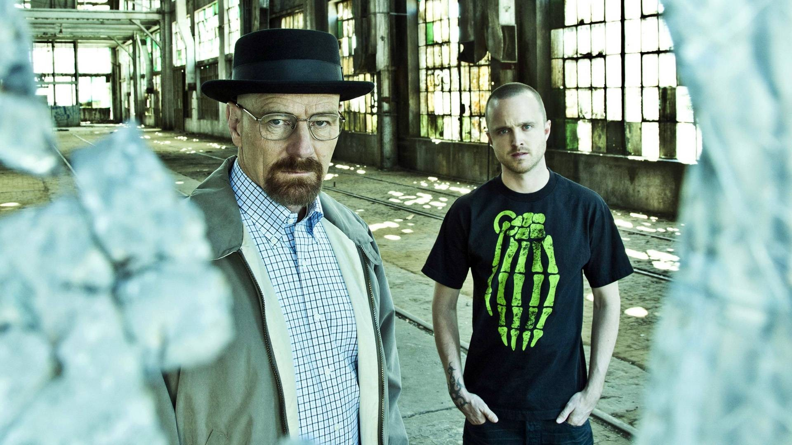
Modeling Human Behavior
What is game theory?
The study of mathematical models of conflict and cooperation between intelligent rational decision-makers

Slide 5
Modeling Human Behavior
How can we mathematically describe the conflicts between two agents?

Slide 6
Game Theory
A model of a rational agent
Preferences
Utility
Choice
Conflicts between agents
Game theoretic models

Slide 7
Preferences

Slide 8
Economic Agent
Which characteristics are required to model an economic agent?
Name, age and gender, personal history, brain structure, cognitive abilities, his emotional state etc
In most of economic theory, an economic agent is modeled only by his attitude toward the elements in some relevant set
His attitude is expressed in the form of preferences

Slide 9
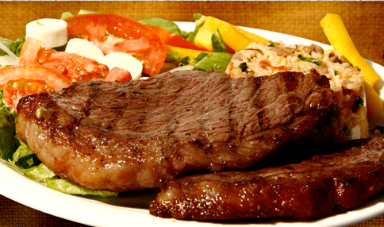
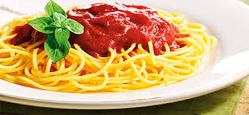
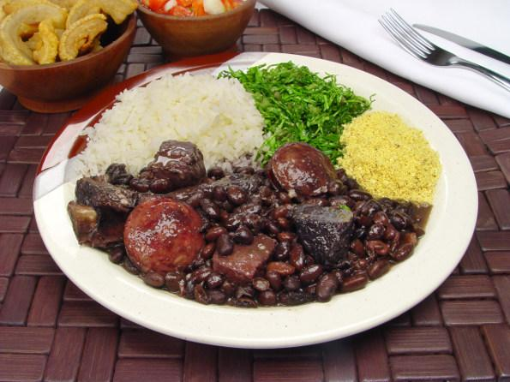
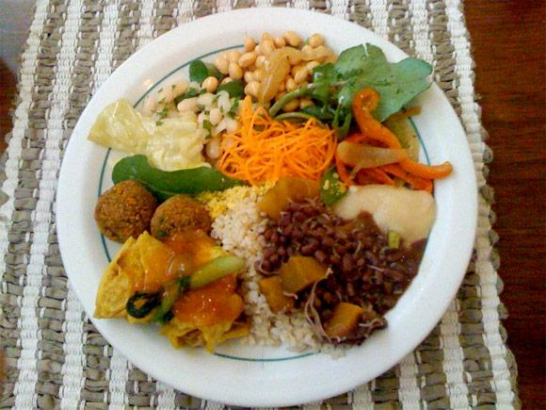
Preferences
Which object in the set X do you prefer?
X

Slide 10
Preferences
A description of preferences should fully specify the attitude of the agent toward each pair of elements in X
X

Slide 11
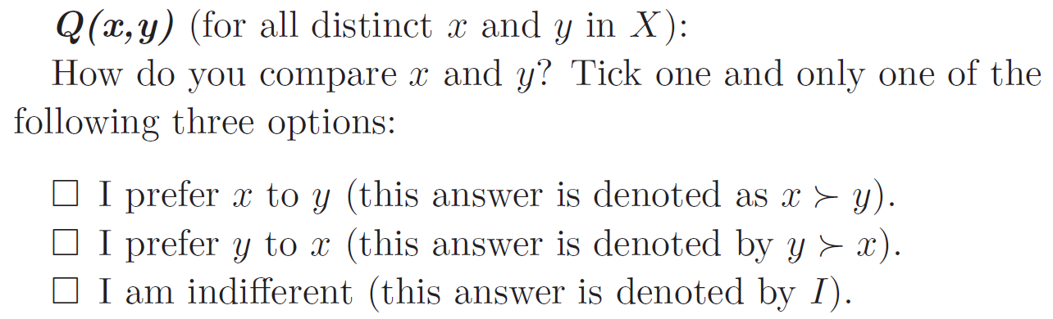
Questionnaire Q
X

Slide 12
Questionnaire Q
A “legal” answer to the questionnaire is a response in which exactly one of the boxes is ticked in each question

Slide 13
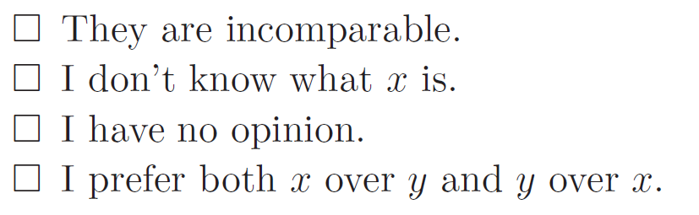
Questionnaire Q
Exclusion of responses that demonstrate a lack of ability to compare, such as:

Slide 14
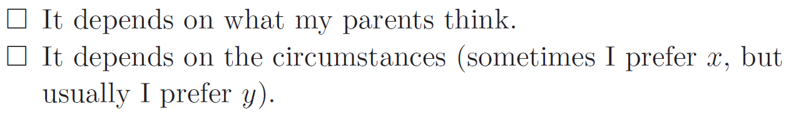
Questionnaire Q
Exclusion of responses that demonstrate a dependence of other factors, such as:

Slide 15
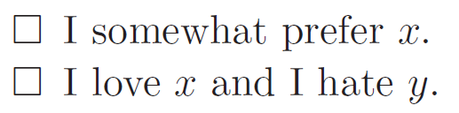
Questionnaire Q
Exclusion of responses that demonstrate an intensity of preferences, such as:

Slide 16
Questionnaire Q
The elements in the set X are all comparable and the intensity of preferences are ignored
X

Slide 17
Questionnaire Q
A legal answer to the questionnaire can be formulated as a function f,
which assigns to any pair (x, y) of distinct elements in X exactly one of the three “values”,
x ≻ y or
y ≻ x or
I,
with the interpretation that f(x, y) is the answer to the question Q(x, y)

Slide 18
Questionnaire Q
x ≻ y
Q(x, y) → f(x, y)
y ≻ x
I

Slide 19
Preference symbol
y ≻ x

Slide 20
Preferences
Definition 1
Preferences on a set X are a function f
that assigns to any pair (x, y) of distinct elements in X exactly one of the three “values”
x ≻ y, y ≻ x, or I
so that for any three different elements x, y, and z in X, the following two properties hold:
No order effect: f(x, y) = f(y, x)
Transitivity:
if f(x, y) = x ≻ y and f(y, z) = y ≻ z, then f(x, z) = x ≻ z and
if f(x, y) = I and f(y, z) = I, then f(x, z) = I

Slide 21
A discussion of transitivity
How would you react if somebody told you she/he prefers x to y, y to z, and z to x?

Slide 22
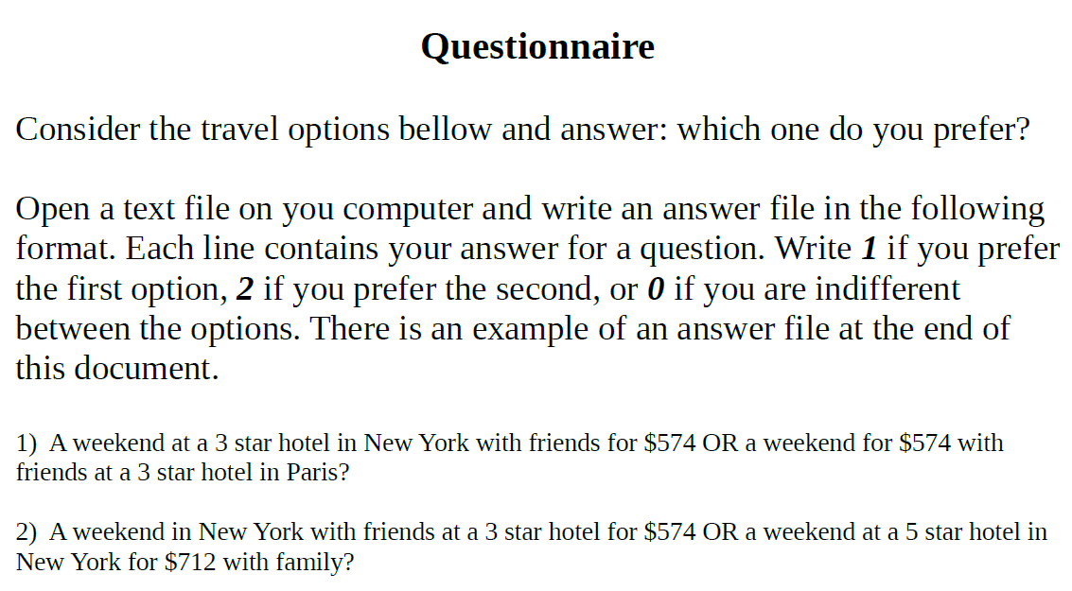
A discussion of transitivity

Slide 23
A discussion of transitivity
There is a direct edge from i to j if j ≻ i
a
b

Slide 24
A discussion of transitivity
How to check intransitivities from this questionnaire?
a
b
intransitivity detected!
c
d

Slide 25
A discussion of transitivity
And if I am indifferent between a and c?
a
b
c
d

Slide 26
A discussion of transitivity
And if I am indifferent between a and c?
a,c
b
d

Slide 27
A discussion of transitivity
How would you react if somebody told you he prefers x to y, y to z, and z to x?
Out of 6 students who responded questionnaire Q1 in 2025/01…
...3 (50%) had no intransitivities
The median number intransitivities per student was 0.5
The mean was 1.17

Slide 28
Easy questions?
6) A weekend at a 5 star hotel with romance for $842 in New York OR a weekend at a 5 star hotel for $574 in New York with romance?
30) A weekend in New York at a 3 star hotel for $842 with friends OR a weekend at a 5 star hotel for $574 in New York with friends?
31) A weekend with friends at a 5 star hotel in New York for $842 OR a weekend for $842 with friends in New York at a 3 star hotel?
37) A weekend with friends in Paris at a 5 star hotel for $574 OR a weekend at a 3 star hotel for $574 with friends in Paris?
38) A weekend with friends at a 3 star hotel for $574 in Paris OR a weekend at a 3 star hotel with friends for $842 in Paris?
39) A weekend for $574 with romance at a 5 star hotel in New York OR a weekend for $842 at a 3 star hotel in New York with romance?

Slide 29
Easy questions?
How would you react if somebody fails to answer those easy questions?
Out of 6 students who responded questionnaire Q1 in 2025/01…
...2 (~33%) gave unreasonable answers to the easy questions

Slide 30
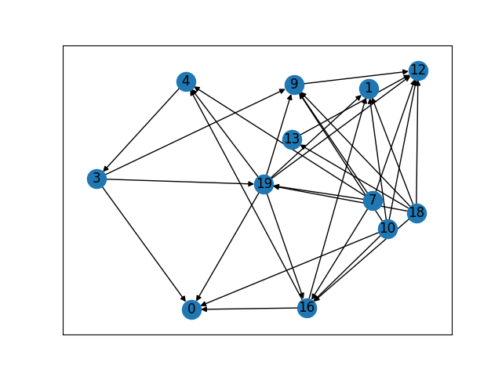
Thiago Assis
Number of nodes: 12
Number of cycles: 2
Cycles: [[16, 4, 3, 19], [3, 19, 4]]
Number of edges 31
Number of dominated choices: 2

Slide 31
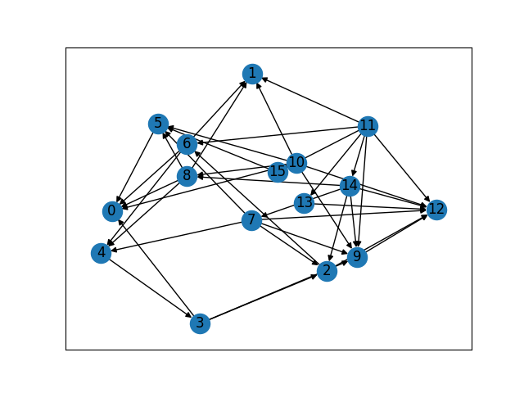
Laila Melo
Number of nodes: 16
Number of cycles: 1
Cycles: [[2, 6, 4, 3]]
Number of edges 40
Number of dominated choices: 0

Slide 32
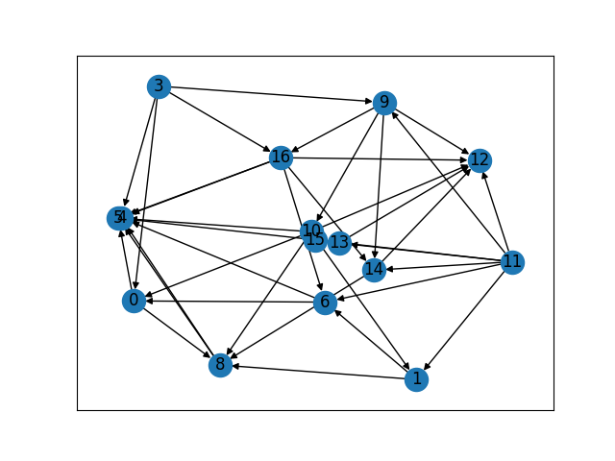
Henrique Magalhães
Number of nodes: 15
Number of cycles: 0
Cycles: []
Number of edges 37
Number of dominated choices: 0

Slide 33
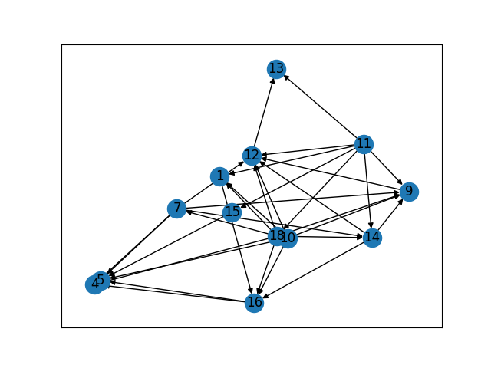
Haniel Botelho
Number of nodes: 13
Number of cycles: 0
Cycles: []
Number of edges 33
Number of dominated choices: 3

Slide 34
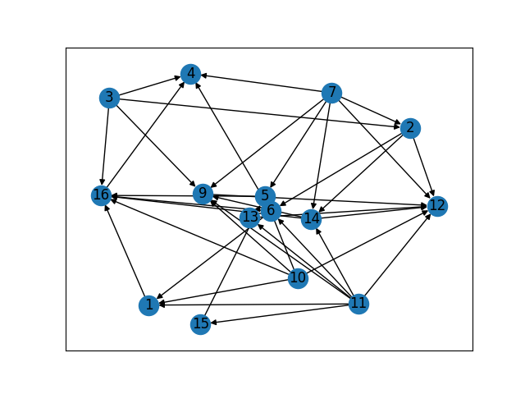
Lorenzo Correa
Number of nodes: 15
Number of cycles: 0
Cycles: []
Number of edges 37
Number of dominated choices: 0

Slide 35
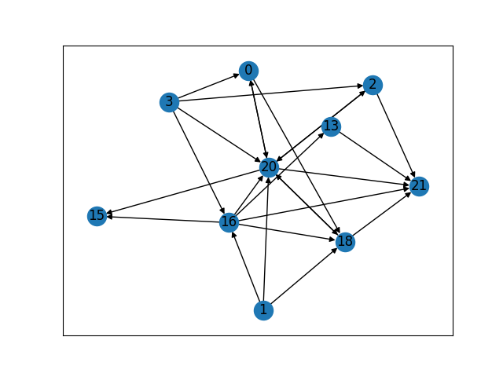
Matheus Farnese
Number of nodes: 10
Number of cycles: 4
Cycles: [[0, 20], [0, 18, 20], [2, 20], [18, 20]]
Number of edges 24
Number of dominated choices: 0

Slide 36
Semestres Anteriores

Slide 37
A discussion of transitivity
How would you react if somebody told you he prefers x to y, y to z, and z to x?
Out of 13 students who responded questionnaire Q1 in 2024/01…
...6 (~46%) had no intransitivities
The median number intransitivities per student was 1
The mean was 5.15

Slide 38
Easy questions?
How would you react if somebody fails to answer those easy questions?
Out of 13 students who responded questionnaire Q1 in 2024/01…
...1 (~8%) gave unreasonable answers to the easy questions

Slide 39
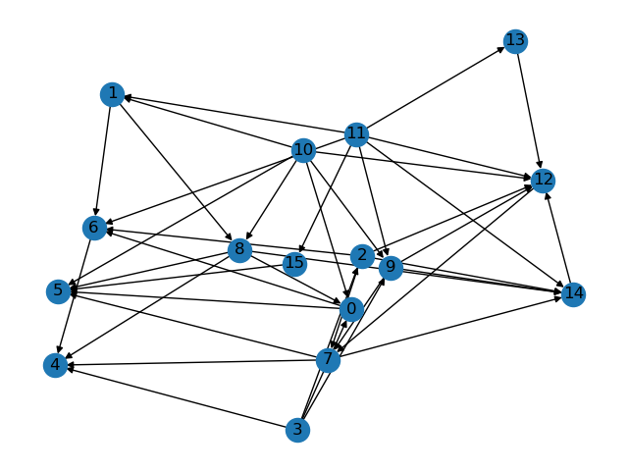
A discussion of transitivity
# of intransitivities: 1 (AV)
[12, 7, 14]

Slide 40
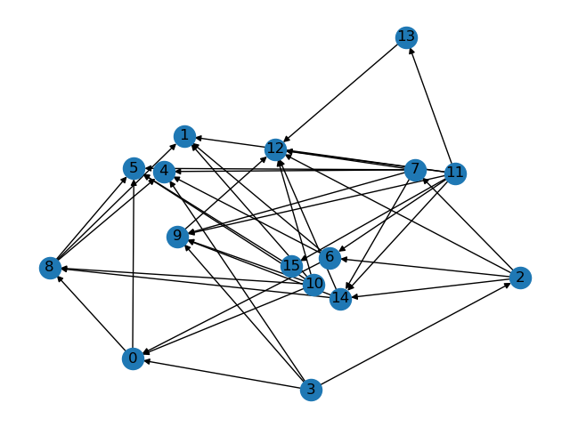
A discussion of transitivity
# of intransitivities: 0 (AA)

Slide 41
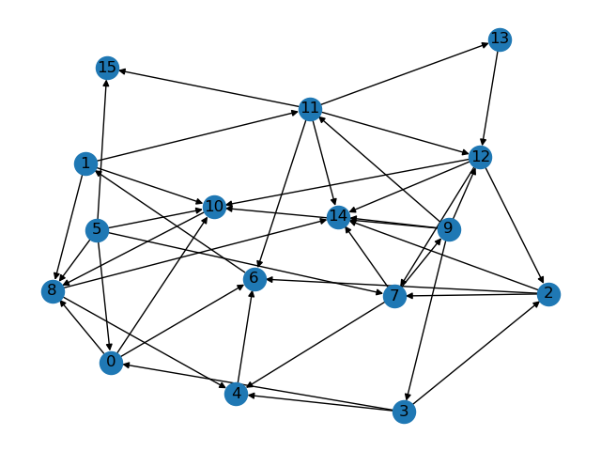
A discussion of transitivity
# of intransitivities: 40 (AB)

Slide 42
[[0, 10, 8, 4, 6, 1, 11, 13, 12, 7, 9, 3], [0, 10, 8, 4, 6, 1, 11, 13, 12, 2, 7, 9, 3], [0, 10, 8, 4, 6, 1, 11, 12, 7, 9, 3], [0, 10, 8, 4, 6, 1, 11, 12, 2, 7, 9, 3], [0, 8, 4, 6, 1, 11, 13, 12, 7, 9, 3], [0, 8, 4, 6, 1, 11, 13, 12, 2, 7, 9, 3], [0, 8, 4, 6, 1, 11, 12, 7, 9, 3], [0, 8, 4, 6, 1, 11, 12, 2, 7, 9, 3], [0, 6, 1, 11, 13, 12, 7, 9, 3], [0, 6, 1, 11, 13, 12, 2, 7, 9, 3], [0, 6, 1, 11, 12, 7, 9, 3], [0, 6, 1, 11, 12, 2, 7, 9, 3], [1, 11, 13, 12, 7, 4, 6], [1, 11, 13, 12, 7, 9, 10, 8, 4, 6], [1, 11, 13, 12, 7, 9, 3, 4, 6], [1, 11, 13, 12, 7, 9, 3, 2, 6], [1, 11, 13, 12, 10, 8, 4, 6], [1, 11, 13, 12, 2, 7, 4, 6], [1, 11, 13, 12, 2, 7, 9, 10, 8, 4, 6], [1, 11, 13, 12, 2, 7, 9, 3, 4, 6], [1, 11, 13, 12, 2, 6], [1, 11, 12, 7, 4, 6], [1, 11, 12, 7, 9, 10, 8, 4, 6], [1, 11, 12, 7, 9, 3, 4, 6], [1, 11, 12, 7, 9, 3, 2, 6], [1, 11, 12, 10, 8, 4, 6], [1, 11, 12, 2, 7, 4, 6], [1, 11, 12, 2, 7, 9, 10, 8, 4, 6], [1, 11, 12, 2, 7, 9, 3, 4, 6], [1, 11, 12, 2, 6], [1, 11, 6], [1, 8, 4, 6], [1, 10, 8, 4, 6], [2, 7, 9, 11, 13, 12], [2, 7, 9, 11, 12], [2, 7, 9, 3], [2, 7, 9, 12], [7, 9, 11, 13, 12], [7, 9, 11, 12], [7, 9, 12]]

Slide 43
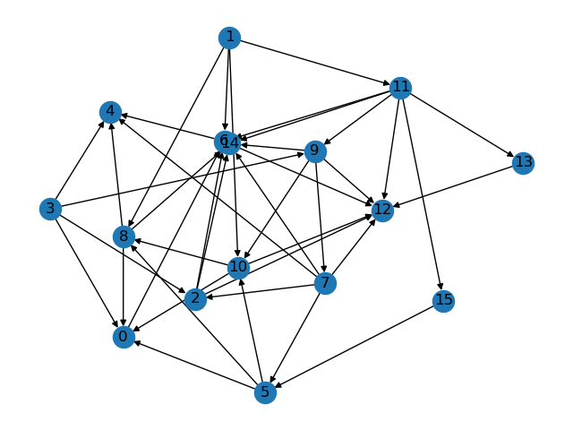
A discussion of transitivity
# of intransitivities: 0 (AD)

Slide 44
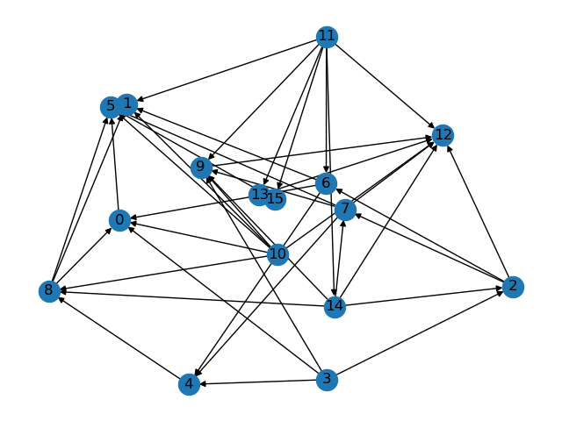
A discussion of transitivity
# of intransitivities: 0 (GL)

Slide 45
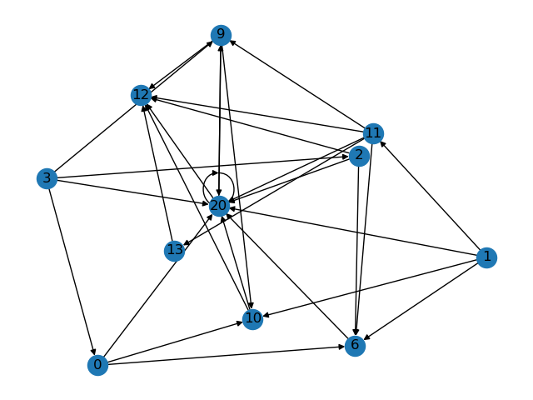
A discussion of transitivity
# of intransitivities: 3 (KN)
[20]
[9, 20]
[9, 10, 20]

Slide 46
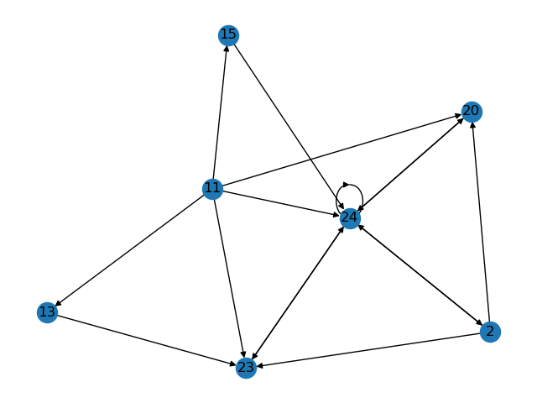
A discussion of transitivity
# of intransitivities: 6 (LD)
[24], [24,23]
[24, 20], [24, 2]
[24, 2, 23],
[24, 2, 20]

Slide 47
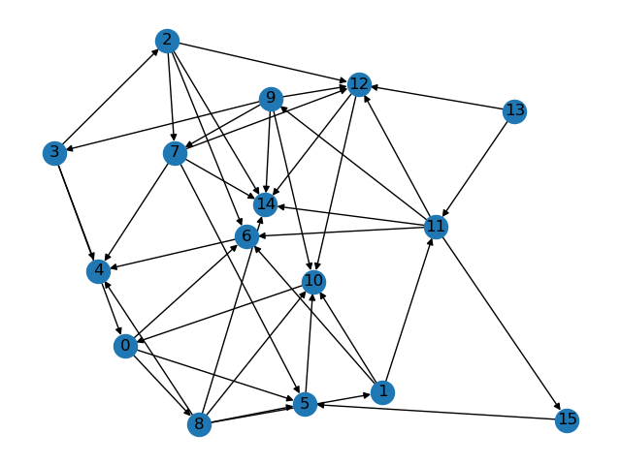
A discussion of transitivity
# of intransitivities: 14 (LR)
[24], [24,23]
[24, 20], [24, 2]
[24, 2, 23],
[24, 2, 20]

Slide 48
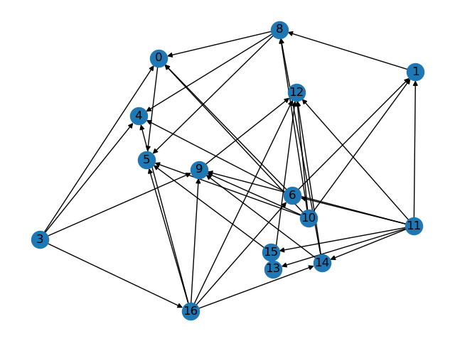
A discussion of transitivity
# of intransitivities: 0 (LR)

Slide 49
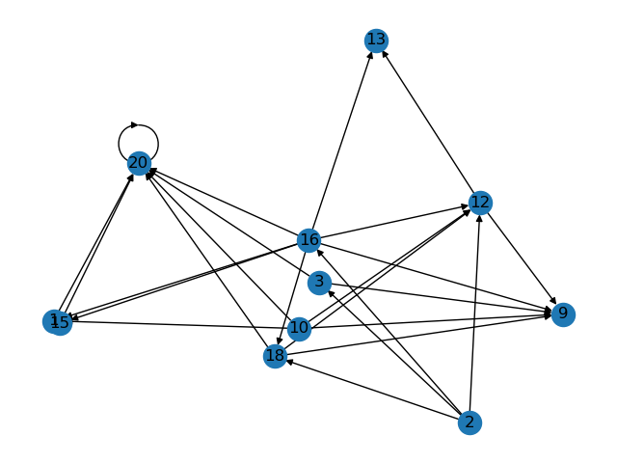
A discussion of transitivity
# of intransitivities: 1 (MM)
[20]
unreasonable answer detected: 6 1
unreasonable answer detected: 38 2
unreasonable answer detected: 39 2

Slide 50
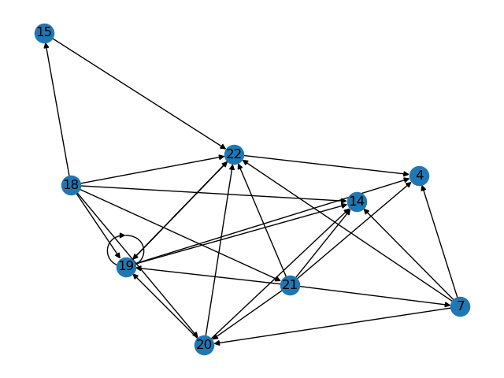
A discussion of transitivity
# of intransitivities: 2 (MI)
[19]
[19, 22]

Slide 51
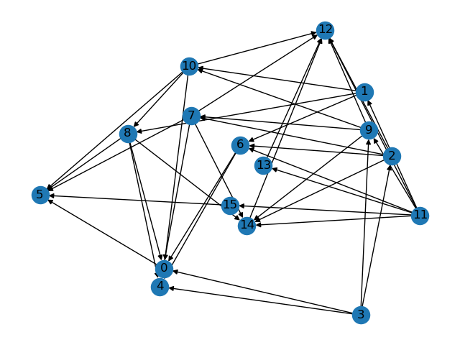
A discussion of transitivity
# of intransitivities: 0 (PF)

Slide 52
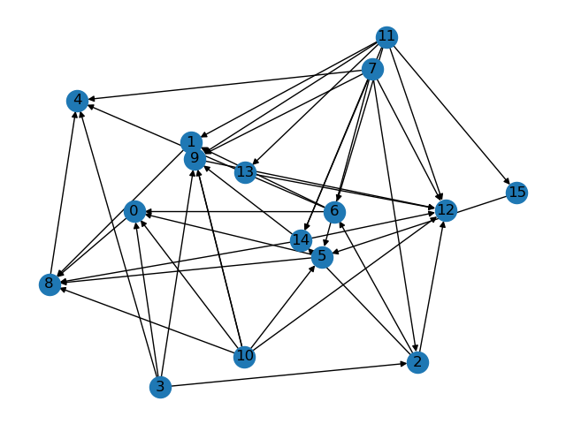
A discussion of transitivity
# of intransitivities: 0 (PS)

Slide 53
Easy questions?
How would you react if somebody fails to answer those easy questions?
Out of 15 students who responded questionnaire Q1 in 2022/01…
...3 (20%) gave unreasonable answers to the easy questions

Slide 54
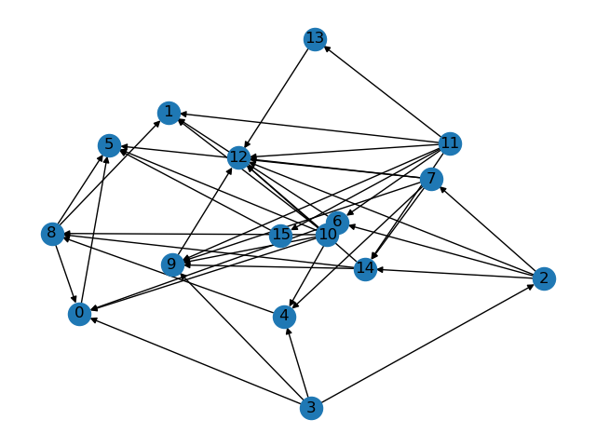
A discussion of transitivity
# of intransitivities: 0 (AR)

Slide 55
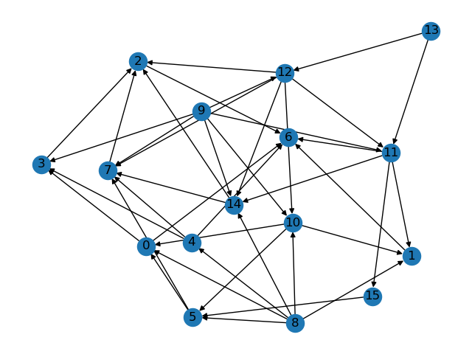
A discussion of transitivity
# of intransitivities: 0 (AP)

Slide 56
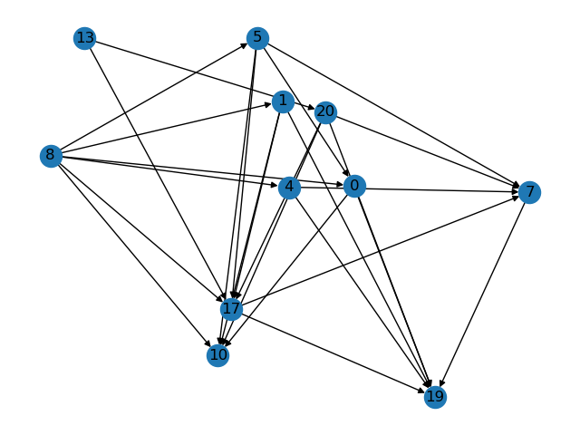
A discussion of transitivity
# of intransitivities: 0 (BM)
5/6 unreasonable answers

Slide 57
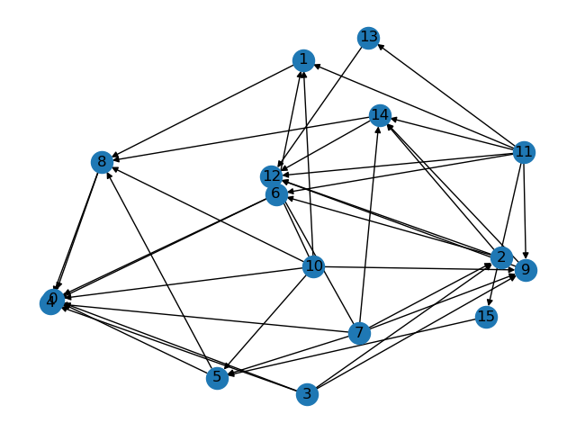
A discussion of transitivity
# of intransitivities: 0 (EM)

Slide 58
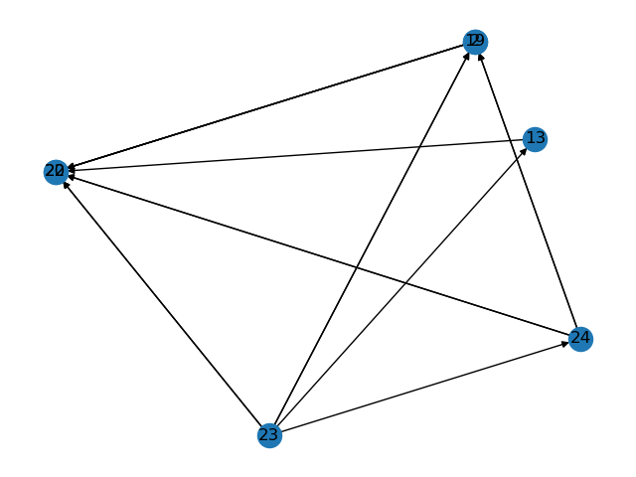
A discussion of transitivity
# of intransitivities: 0 (EV)

Slide 59
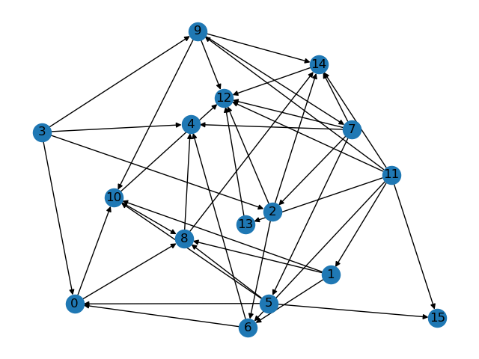
A discussion of transitivity
# of intransitivities: 0 (GU)

Slide 60
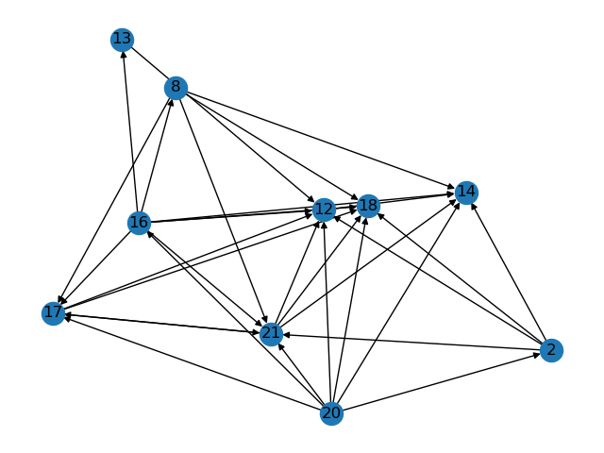
A discussion of transitivity
# of intransitivities: 1 (GD)

Slide 61
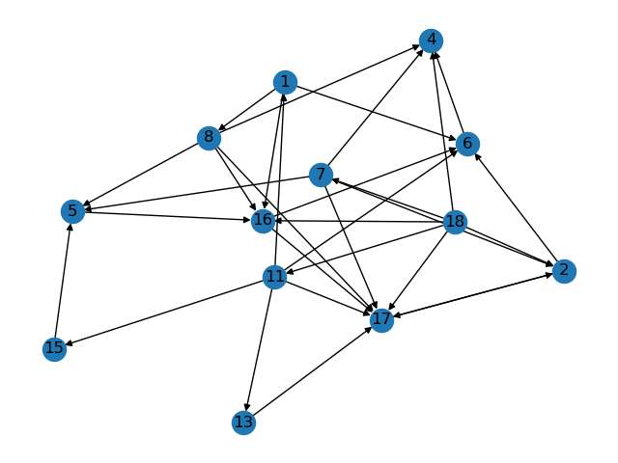
A discussion of transitivity
# of intransitivities: 1 (GG)

Slide 62
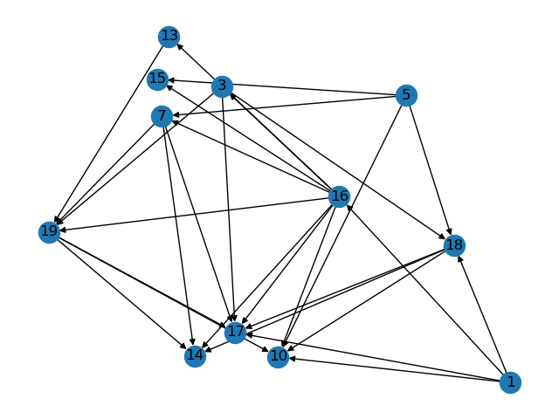
A discussion of transitivity
# of intransitivities: 0 (LG)

Slide 63
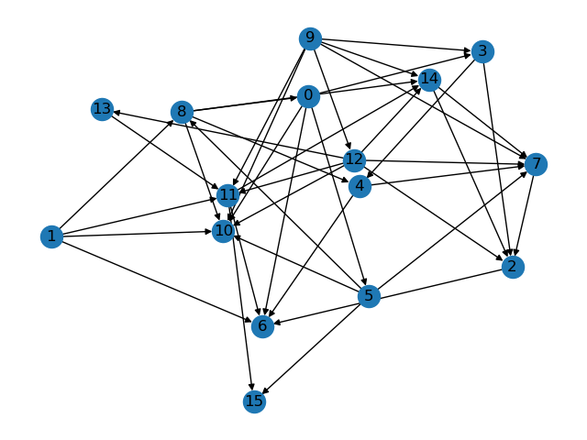
A discussion of transitivity
# of intransitivities: 0 (LA)
1/1 unreasonable answers

Slide 64
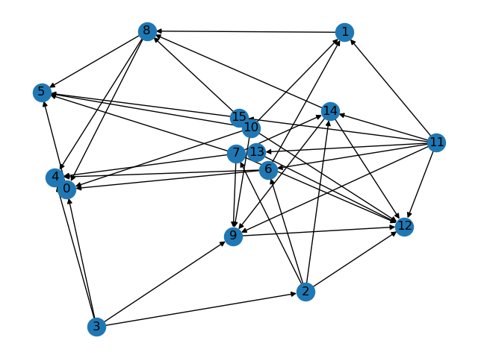
A discussion of transitivity
# of intransitivities: 0 (LH)

Slide 65
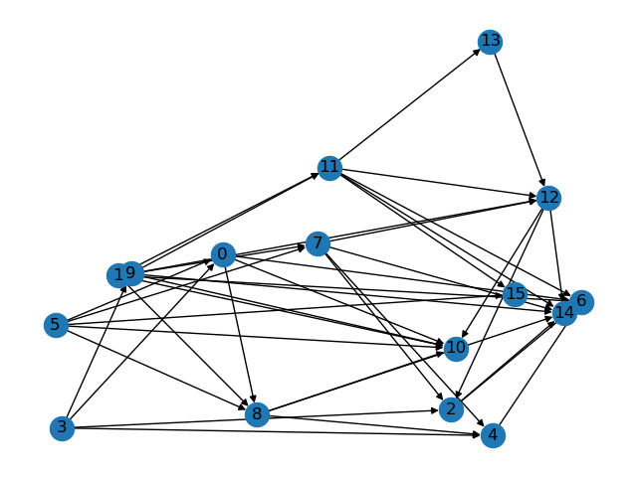
A discussion of transitivity
# of intransitivities: 0 (PS)

Slide 66
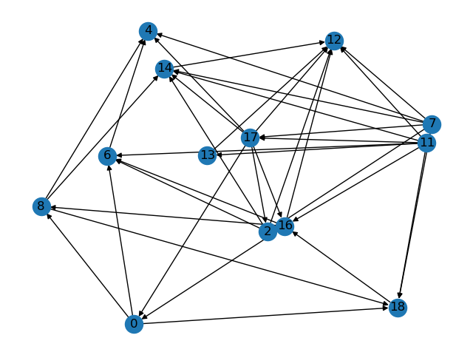
A discussion of transitivity
# of intransitivities: 3 (RS)

Slide 67
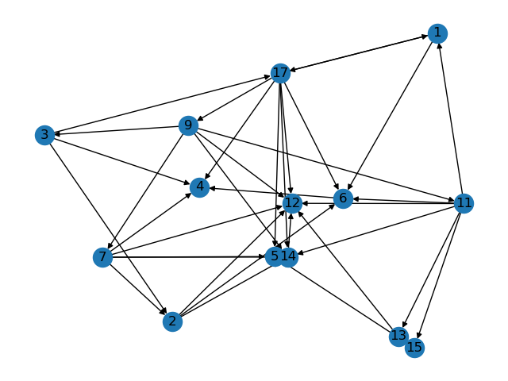
A discussion of transitivity
# of intransitivities: 4 (SS)

Slide 68
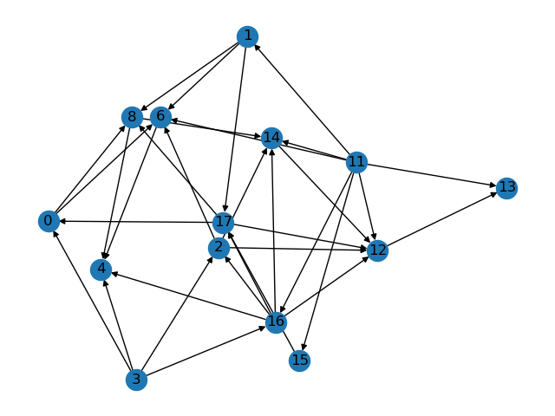
A discussion of transitivity
# of intransitivities: 0 (TP)
1/6 unreasonable answers

Slide 69
A discussion of transitivity
How would you react if somebody told you he prefers x to y, y to z, and z to x?
Out of 63 students who responded questionnaire Q1 in 2019/02…
...31 (49%) had no intransitivities
The median number intransitivities per student was 1
The mean was 6.68 (!)

Slide 70
Easy questions?
How would you react if somebody fails to answer those easy questions?
Out of 63 students who responded questionnaire Q1 in 2019/02…
...13 (21%) gave unreasonable answers to the easy questions

Slide 71
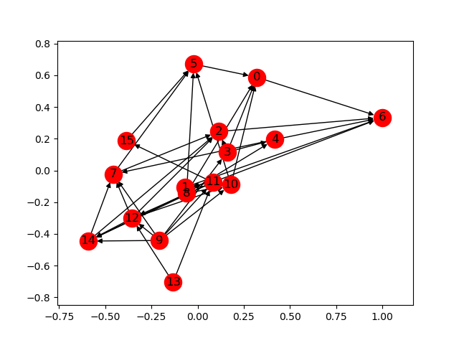
A discussion of transitivity
# of intransitivities: 0 (I. E.)

Slide 72
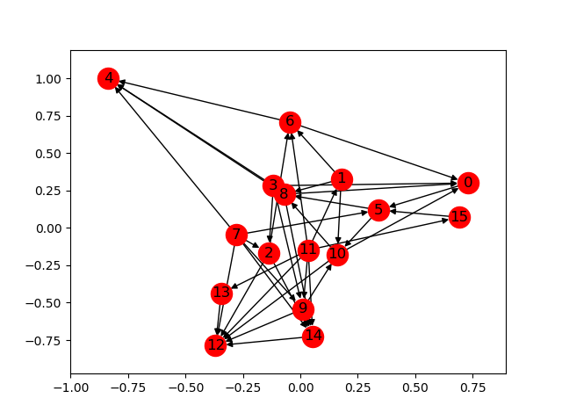
A discussion of transitivity
# of intransitivities: 3 (A. M.)

Slide 73
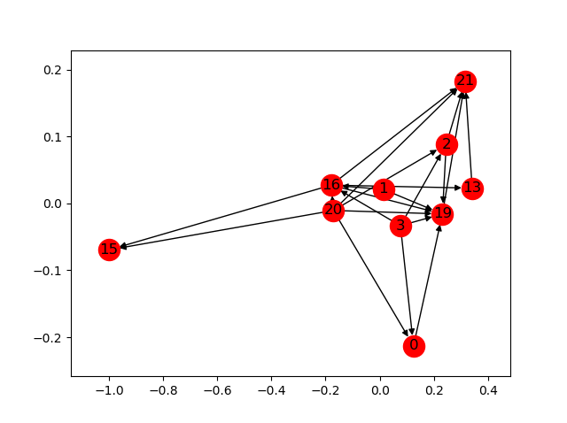
A discussion of transitivity
# of intransitivities: 0 (K. C.)

Slide 74
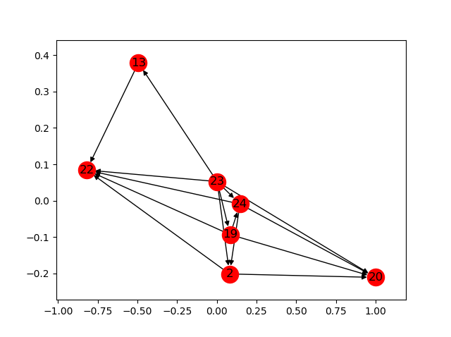
A discussion of transitivity
# of intransitivities: 0 (L. C.)

Slide 75
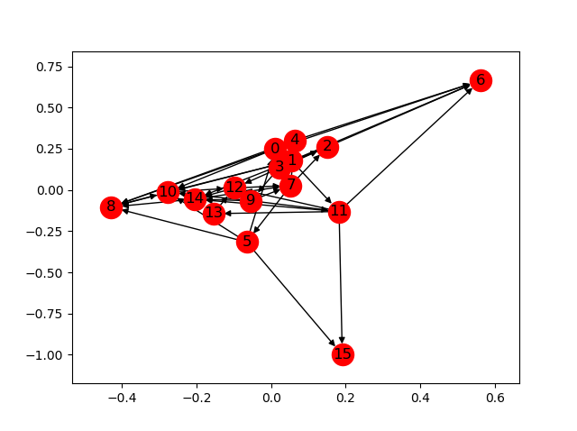
A discussion of transitivity
# of intransitivities: 15 (S. A.)

Slide 76
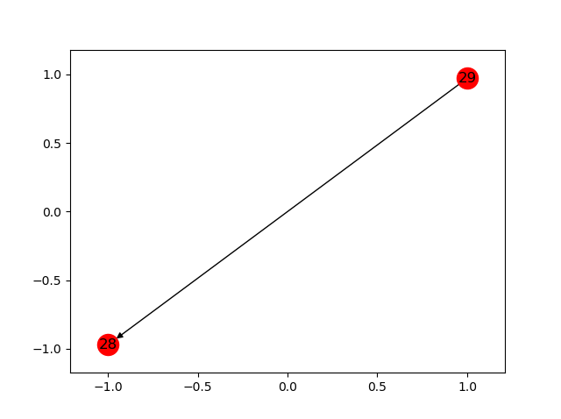
A discussion of transitivity
# of intransitivities: 0 (I. R.)

Slide 77

A discussion of transitivity
# of intransitivities: 0 (R. C.)
5/6 unreasonable answers

Slide 78

A discussion of transitivity
# of intransitivities: 1 (T. S.)
2/6 unreasonable answers

Slide 79

A discussion of transitivity
# of intransitivities: 126 (A. F.)
3/6 unreasonable answers

Slide 80
A discussion of transitivity
# of intransitivities: 0 (G. F.)
6/6 unreasonable answers

Slide 81
A discussion of transitivity
How would you react if somebody told you he prefers x to y, y to z, and z to x?
Out of 38 students who responded questionnaire Q1 in 2017/02…
...only 4 (10.5%) had no intransitivities
The median number intransitivities per student was 2.5
The mean was 13.18 (!)

Slide 82
A discussion of transitivity
How would you react if somebody told you he prefers x to y, y to z, and z to x?
Out of 39 students who responded questionnaire Q1 in 2016/02…
...only 3 (7.7%) had no intransitivities
The median number intransitivities per student was 4
The mean was 12.1 (!)

Slide 83
A discussion of transitivity
How would you react if somebody told you he prefers x to y, y to z, and z to x?
Out of 27 students who responded questionnaire Q1 in 2015/02…
...only 4 (14.8%) had no intransitivities
The median number intransitivities per student was 3
The mean was 15.4 (!)

Slide 84
A discussion of transitivity
How would you react if somebody told you he prefers x to y, y to z, and z to x?
Out of 458 students who responded a simple preference questionnaire (details in the book),
only 57 (12.44%) had no intransitivities in their answers,
The median number intransitivities per student was 7

Slide 85
Procedures that cause violations of transitivity
Any ideas?

Slide 86

Procedures that cause violations of transitivity
Being crazy?

Slide 87

Procedures that cause violations of transitivity
Being lazy?

Slide 88
Procedures that cause violations of transitivity
Aggregation of considerations as a source of intransitivity
X = {a, b, c} and the individual has three primitive considerations in mind (eg: price, taste, quality)
The individual finds an alternative x better than an alternative y if a majority of considerations supports x
If the three considerations rank the alternatives as a ≻₁ b ≻₁ c, b ≻₂ c ≻₂ a, and c ≻₃ a ≻₃ b, then…
… the individual determines a to be preferred over b, b over c, and c over a, thus violating transitivity

Slide 89
Procedures that cause violations of transitivity
The use of similarities as an obstacle to transitivity
In some cases, an individual may express indifference in a comparison between two elements that are too “close” to be distinguishable
Let X be the set of real numbers
Consider an individual whose attitude toward the alternatives is “the larger the better”, but he cannot determine whether a is greater than b unless the difference is at least 1
He will assign f(x, y) = x ≻ y if x ≥ y + 1 and f(x, y) = I if |x − y| < 1
Is this function always transitive?
This is not a preference relation because 1.5 ∼ 0.8 and 0.8 ∼ 0.3, but it is not true that 1.5 ∼ 0.3

Slide 90
Preferences
Definition 1
Preferences on a set X are a function f
that assigns to any pair (x, y) of distinct elements in X exactly one of the three “values”
x ≻ y, y ≻ x, or I
so that for any three different elements x, y, and z in X, the following two properties hold:
No order effect: f(x, y) = f(y, x)
Transitivity:
if f(x, y) = x ≻ y and f(y, z) = y ≻ z, then f(x, z) = x ≻ z and
if f(x, y) = I and f(y, z) = I, then f(x, z) = I

Slide 91
A discussion of transitivity
Is this definition weak?
For example, if f(x, y) = x ≻ y and f(y, z) = I, can f(x, z) be different than x ≻ z?
No! Proof in the book

Slide 92

Questionnaire R

Slide 93
Questionnaire R
By a “legal” response we mean that the respondent ticks exactly one of the boxes in each question
To qualify as preferences, a legal response must also satisfy two conditions:
The answer to at least one of the questions R(x, y) and R(y, x) must be Yes
For every x, y, z ∈ X, if the answers to the questions R(x, y) and R(y, z) are Yes, then so is the answer to the question R(x, z)

Slide 94
The equivalence of the two definitions
If I get a questionnaire Q from “Smith”, can I fill questionnaire R for “Smith”?

Slide 95
Reminder: relation
Domain A
Range B
3.4
2
-4
6
108
A relation R is a set of ordered pairs

Slide 96
Reminder: relation
Domain A
Range B
3.4
999
200
-4
-6
108
R ⊆ A x B = {(a,b) | a ∈ A ^ b ∈ B}

Slide 97
Reminder: relation
Domain A
Range B
3.4
999
200
-4
-6
108
R = {(3.4,-4), (200,-4), (200,108)}

Slide 98
Questionnaire R
We identify a response to this questionnaire with the binary relation ≿ on the set X defined by x ≿ y if the answer to the question R(x, y) is Yes
Ex: If x is at least as preferred as y, then x ≿ y

Slide 99
Reminder
An n-ary relation on X is a subset of X^{n}
Examples:
“Being a parent of” is a binary relation on the set of human beings
“being a hat” is an unary relation on the set of objects
“x + y = z” is a 3-ary relation on the set of numbers
“ x is better than y more than x′ is better than y′ ” is 4-ary relation on a set of alternatives

Slide 100
Reminder
An n-ary relation on X can be thought of as a response to a questionnaire regarding all n-tuples of elements of X where each question can get only a Yes answer
Ex: is a₁ ≿ a₂ ≿ a₃ ≿ … ≿ a_{n} ? (Yes)

Slide 101
Preferences
Definition 2
Preferences on a set X is a binary relation ≿ on X satisfying:
Completeness: For any x, y ∈ X, x ≿ y, or y ≿ x
Transitivity: For any x, y, z ∈ X, if x ≿ y and y ≿ z, then x ≿ z

Slide 102
The equivalence of the two definitions
If I get a questionnaire Q from “Smith”, can I fill questionnaire R for “Smith”?

Slide 103
Reminder
The function f : X → Y is a one-to-one function (or injection) if f(x) = f(y) implies that x = y
Ex: Brazilians → CPF number
The function f : X → Y is an onto function (or surjection) if for every y ∈ Y there is an x ∈ X such that f(x) = y
Ex: people → country of birth
The function f : X → Y is a one-to-one and onto function (or bijection, or one-to-one correspondence) if for every y ∈ Y there is a unique x ∈ X such that f(x) = y
Ex: Brazilians→ Passport

Slide 104



Reminder

Slide 105
The equivalence of the two definitions
If I get a questionnaire Q from “Smith”, can I fill questionnaire R for “Smith”?
We need to construct a one-to-one and onto function answers to Q and answers to R, such that the correspondence preserves the meaning of the responses to the two questionnaires

Slide 106

The equivalence of the two definitions

Slide 107
Summary
Preferences on X are a binary relation ≿ on a set X satisfying completeness and transitivity
Notate x ≻ y when both x ≿ y and not y ≿ x, and x ∼ y when x ≿ y and y ≿ x

Slide 108
Summary
Now, with one single relation (≿), we can describe the full preference relation towards the items in X
With questionnaire Q, we needed two relations: ≻ and I

Slide 109
Summary
Modeling exercise with two methodological points
1. When we introduce two formalizations of the same verbal concept, we have to make sure that they indeed carry the same meaning
2. When we construct a formal concept, we make assumptions beyond those explicitly mentioned. Being aware of the implicit assumptions is important for understanding the concept and is useful in coming up with ideas for alternative formalizations

Slide 110
Fun problem
Let's listen to the Shepard tone
https://www.youtube.com/watch?v=BzNzgsAE4F0
Can you think of any economic analogies?

Slide 111
Fun problem
Roll a die and get a prize! Which lottery do you prefer?
 | 1 | 2 | 3 | 4 | 5 | 6
L1 | $1000 | $500 | $600 | $700 | $800 | $900
L2 | $900 | $1000 | $500 | $600 | $700 | $800

Slide 112
Fun problem
Roll a die and get a prize! Which lottery do you prefer?
 | 1 | 2 | 3 | 4 | 5 | 6
L1 | $1000 | $500 | $600 | $700 | $800 | $900
L2 | $900 | $1000 | $500 | $600 | $700 | $800
L3 | $800 | $900 | $1000 | $500 | $600 | $700

Slide 113
Fun problem
Roll a die and get a prize! Which lottery do you prefer?
 | 1 | 2 | 3 | 4 | 5 | 6
L1 | $1000 | $500 | $600 | $700 | $800 | $900
L2 | $900 | $1000 | $500 | $600 | $700 | $800
L3 | $800 | $900 | $1000 | $500 | $600 | $700
L4 | $700 | $800 | $900 | $1000 | $500 | $600
L5 | $600 | $700 | $800 | $900 | $1000 | $500
L6 | $500 | $600 | $700 | $800 | $900 | $1000

